Slide 1

Lecture 1: Introduction
WRPV301: Advanced Programming
Dr Simone Beets

Slide 2
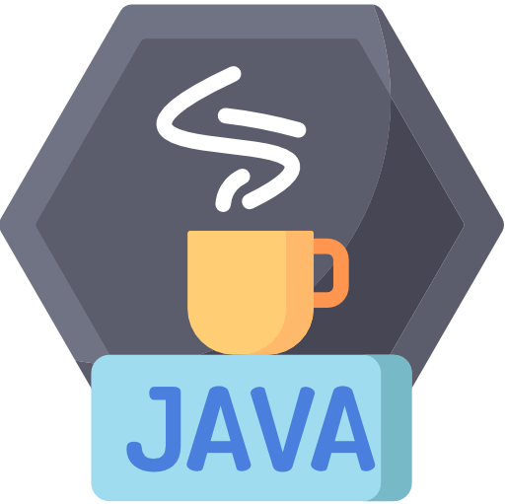
Java

Slide 3
Java
Current latest stable version: 25
Many interesting language features
Started adding functional language-like features around version 9
Most in-demand programming languages | Most in-demand programming languages
# | Jan 2023 | Jan 2024 | Jan 2025 | Jan 2026
1 | JavaScript | Python | Python | Python
2 | Python | JavaScript | Java | JavaScript
3 | Go | Java | C++ | Java
4 | Java | C# | C# | C#
5 | Kotlin | Swift | JavaScript | Swift
6 | PHP | TypeScript | TypeScript | TypeScript
7 | C# | PHP | C | Kotlin
8 | Swift | Ruby | Shell | Ruby
9 |  |  | Go | Rust
10 |  |  | R | Go
Notes:
Features:
OOP, portability, security
OOP:
Supporting concepts like inheritance, encapsulation & polymorphism
Portability:
Write once run anywhere concept
Security:
Known for its security features
Multithreading:
Allows programs to run multiple tasks at the same time
Improves performance
Robustness:
Uses strong memory management & automatic garbage collection
Ref:
2024: https://codeworks.me/blog/10-most-in-demand-programming-languages-in-2024/
2025: https://spectrum.ieee.org/top-programming-languages-2025
2026: https://www.crossover.com/resources/top-10-in-demand-programming-languages-for-2026-updated

Slide 4
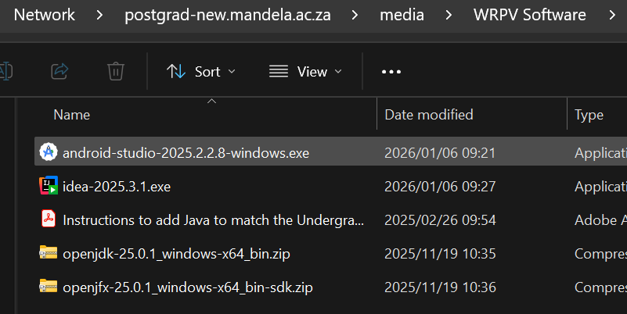
Java
We use Java language level 11 for this module
If installing IntelliJ at home, use the files available in the WRPV software folder →
Use the exact versions as these are the versions that are installed in the CS labs
\\postgrad-new.mandela.ac.za\media\WRPV Software

Slide 5
Some updates in 2026
If you are a returning student, but did not take WRAV2 or this module in 2025, please see me to help you catch up on Java
For everyone: From last year, Java was also taught in WRAV2, so take a look at the recap slides for some basics

Slide 6
Java
Often distributed in
a .jar file
MyProg.java
MyProg.class
Source Code
Source Code
Source Code
Class Files
Editor
Compiler
Virtual Machine
Running Program
IntelliJ
Netbeans
Eclipse
Jenuity
Notepad
...
javac.exe
Library Files
Notes:
Source code:
Write source code in java (.java file)
Compiler:
Java compiler (javac) compiles this source code into bytecode, and that is stored in a .class file
Bytecode is an intermediate, platform-independent representation of your code
Class & library files → VM:
Content of each class contained in the source file is stored in a separate .class file
Run the Java program, the Java Virtual Machine (JVM) loads the required .class files & that includes your compiled code & any external libraries (from .jar files / std Java libraries)
The ClassLoader handles loading these files into memory
JVM checks the bytecode that it is correct and for any security issues
The interpreter reads & executes bytecode line by line
The Just in time (JIT) compiler may compile frequently used bytecode into native machine code for better performance
Running program / execution:
CPU executes native machine code from the JIT compiler
Program interacts with the OS, memory & external resources as it is needed

Slide 7

Classes & interfaces

Slide 8
Encapsulation & data hiding
See /Example03
Storing all information & methods of an entity in one class is called Encapsulation
Only allowing fields to be edited through get & set methods is an example of Information Hiding
Allows for validation of setters before changing a value
Allows for formatting of getters before returning a value
Hint: IntelliJ can create constructors, getters & setters, etc., automatically from fields using Code > Generate (ALT+insert)

Slide 9
Inheritance & polymorphism
See /Example04
Java supports single inheritance, but using interfaces, it is possible to simulate multiple inheritance
Student and Lecturer extend Person (inheritance: extends keyword)
A Student or Lecturer object can be assigned to a Person reference
Through polymorphism the correct methods are called
Notes:
Inheritance:
One class is allowed to inherit the features (fields & methods) of another class
Creating new classes based on existing ones
Inheriting class can reuse the methods & fields of that class
Can still add new methods & fields to new class
Why?
Code reusability (code in superclass is common to all subclasses)
Method overriding (only through inheritance, run time polymorphism)
Abstraction (do not have to provide all the details, only show the func to user)
Java does not support multiple inheritance
Class inherits properties of more than one parent class
Polymorphism:
“having many forms”
Ability of message to be displayed in more than one form
e.g. a person can have different characteristics at the same time (man is a father, a husband & an employee)
Same person has different behaviors in different situations
Base class Person – role method
But Father that extends person also has its own role method
So when you call role of a father it will use the method in the Father class

Slide 10
Overriding
See /Example06
Overriding = new implementation of an inherited method
Lecturer provides a new implementation for getName()
This is called overriding
No special keyword needed to override an inherited method (unlike C#)
Can include a sanity check if you want to by including the @Override annotation before the method signature
Forces IntelliJ to check if there is actually a method with the same name to be overridden
If not, an error message is displayed

Slide 11
Overriding (cont.)
When a Lecturer object is assigned to a Person reference, the correct version of getName() is called
That’s why polymorphism is so cool!

Slide 12
Constructors & overloading
See /Example05
Different types of constructors
Default constructor: accepts no parameters
Parameterised constructor: accepts parameters & uses to initialise object
Copy constructor: accepts object of same type & copies values across
Having two (or more) methods with the same name but different parameters is called overloading

Slide 13
Abstract classes & methods
See /Example07
Abstract class
class that cannot be instantiated
can be partially implemented though
Abstract method
method that has been declared, but not implemented
a class with 1..* abstract methods is abstract
Abstract class Person and some of its methods have been declared abstract

Slide 14
Abstract classes & methods (cont.)
All these methods must be implemented by a subclass before it can be instantiated
Implemented in Student class in example
Cannot instantiate Person class but can have a Person reference (line 22) - polymorphism
Abstract classes are useful for
Serving as a base class for a tree of sub-classes, providing common behaviour & properties, e.g., GUI Window/View
Acting as a specific, base class to be used for polymorphic assignments
Providing some common code & letting sub-classes complete an implementation for a specific type of class
Notes:
Serving as a base class for a tree of sub-classes, providing common behaviour & properties, e.g., GUI Window/View
Acting as a specific, base class to be used for polymorphic assignments
Providing some common code & letting sub-classes complete an implementation for a specific type of class

Slide 15
Interfaces
Inheritance hierarchies using extend are typically deep
Tightly coupled
What does coupling mean?
A measure of how much two classes know about & depend on each other
Inheritance is tightest form of coupling
The larger an inheritance hierarchy becomes
More “brittle” it becomes to change
Changes at top ripple down tree

Slide 16
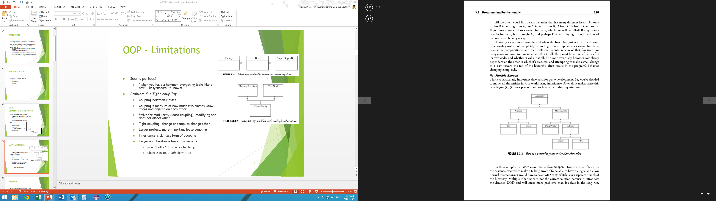
Interfaces
Not Flexible Enough
Really????
Cannot change easily
E.g., what if want a “talking sword” (Sword & NPC)?
Multiple inheritance?
Can lead to “bloat”
Figure from WVRV402 module

Slide 17
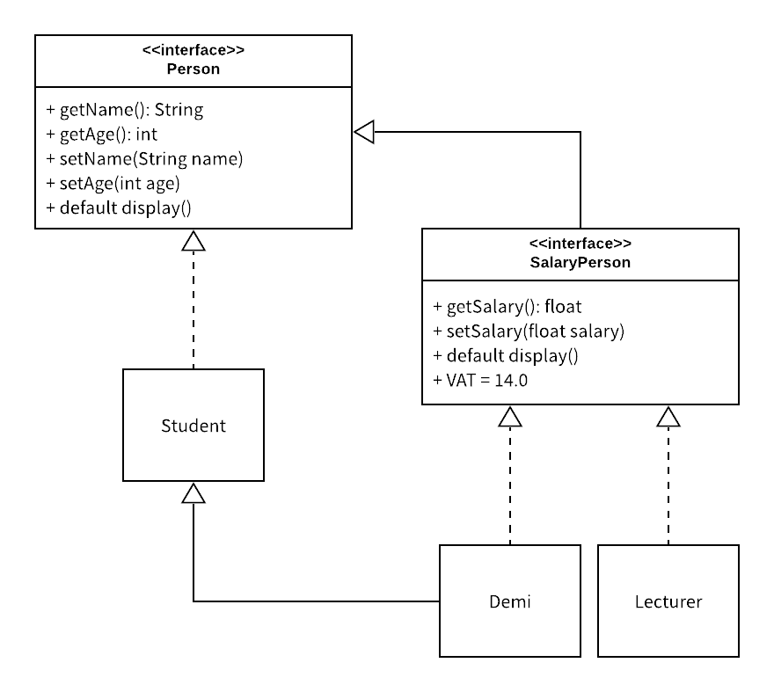
Interfaces
Interface = a set of method definitions (and/or constants) that a class implements
An interface cannot be instantiated
Interfaces do not provide implementations (except default ones)
Method/constants are public by default
Any class implementing an interface can be treated as the interface (polymorphism)
Interface inheritance tends to be broader
Typically use a combination of inheritances

Slide 18
Interfaces
Extend & Implement cardinalities:
Extend (maximum one superclass), e.g. public class A extends B
Implements (many interfaces), e.g. public class A implements I, J, K, L
Example
See /Example08
We would like to create class Demi that extends both Student & Lecturer
Possible Solution: Create interface SalaryPerson & let both Demi and Lecturer implement SalaryPerson
SalaryPerson cannot be instantiated but can be used as a reference to a subclass

Slide 19
Interfaces
An interface may extend another interface using the extend keyword
A default “inherited” method may be altered in the sub-interface
May use the default implementation provided by the parent-interface when doing so
If name clashes with default method provided by multiple interfaces, then implementing class needs to specify which to use
See /Example09
Notes:
SalaryPerson interface that extended Person

Slide 20
Some Java keywords not seen in C#?
abstract
Class: Cannot be instantiated. Only its subclasses can be instantiated
Method: No method body. Must be overridden in non-abstract subclasses. Class must also be declared abstract.
static
Class: Only useful for inner-classes (in a later lecture)
Field: Field belongs to class, not object. There is only one instance of the field. May be accessed using the class. Can be thought of as being “shared” by all instances of the class.
Method: Method belongs to class, not object. May only use other static methods or fields (because all belong to the class).
this
Reference to the instantiated class passed to every non static method

Slide 21
Some Java keywords not seen in C#?
final
Class: Cannot be extended
Field: Value cannot change once set
Method: Cannot be overridden
super
Refers to the inherited members of the parent class

Slide 22
Important classes
Object
boolean equals(Object obj)
Indicates whether obj is “equal to” this one
Class getClass()
Returns the runtime class of this object
Allows reflection (later lecture)
String toString()
Returns a string representing the object

Slide 23
Important classes
Class
Class forName(String className)
Initializes the class with the given string name
String getName()
Returns the name of the entity represented by this Class object, as a String
boolean isInstance(Object obj)
Determines if obj is assignment compatible with the class represented by the Class Object

Slide 24
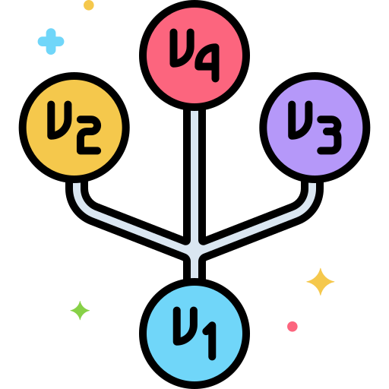
Version Control

Slide 25

Version control
Facilitates continuous software development workflows
Keeps a historical record of software changes in specialised db
Logs edits made by individual developers in this db
Shows any conflicts in the code of changes made by different developers
Conflicts can then be resolved by the developers
Notes:
Developers can work easily together on the same codebase
Can identify conflicting edits & prevent overwrites
See more here:
https://github.com/resources/articles/what-is-version-control

Slide 26
Version control systems (VCSs)
A VCS provides visibility to code history
Also provides a single source of documentation for all files, folders & messages
Advantages?
Improves productivity by streamlining software development lifecycle (SDLC)
Reduces the chance of lost work & time by tracking code changes
Helps to improve code quality (developers need to follow best practices)
Reduces errors (finding errors faster, rolling back)
Improves the recovery process (by keeping track of changes & reverting changes that contain issues)
Automates tasks like testing, analysis & deployment
Notes:
Tracking code changes: from asynchronous & concurrent work
Can identify conflicting edits & prevent overwrites

Slide 27
VCS Features
Repository
Pull request
Commit
Branch
Merge
Conflict
Checkout
Remote
Fork
Revert
Tag
Repository or repo: the centralised db where the files & folders & revision history for a codebase are stored
Pull request: how a dev proposes or reviews changes to the codebase before merging. Also called a merge request.
Commit: a snapshot of changes that identifies proposed changes. Usually uses specific notation for the message (describes the changes).
Branch: a parallel version of the codebase for a dev to work independently without changing the main code.
Merge: where devs combine code changes to integrate them from one branch to another or the main codebase.

Slide 28
VCS Features
Repository
Pull request
Commit
Branch
Merge
Conflict
Checkout
Remote
Fork
Revert
Tag
Tag: a marker used as a label to identify a specific point in the code history, e.g., release date.
Revert: when devs undo or revert a change to a previous version.
Fork: where a separate & distinct copy of the source code is made from an existing codebase.
Remote: devs can work locally (on their desktop), on a company server or on the cloud using VC.
Checkout: how a dev retrieves a file from the VCS.
Conflict: changes made to the same code by two or more devs are shown as a conflict.
Notes:
Q: Difference between a fork and a branch?
Fork: A fork is the process of creating a separate and distinct piece of software by copying source code from an existing software package.
Branch: A code branch is a separate, parallel version of the codebase created by developers to work independently on experiments, regression testing, and debugging without changing the main codebase.

Slide 29
VC Best practices
Best practices
Complete repo setup
Clear workflow alignment
Write clear commit messages
Commit often
Test before committing code
Commit code only when ready
Avoid conflicts
Limit repo access
Use branches
Notes:
Complete: access control, disaster recovery, failover plans
Workflow alignment: team needs to agree on & be aware of workflow
How to avoid conflicts?
* Pull latest version of branch that you branched off of to: 1. get the latest code & 2. see if there are conflicts already pushed up that you can resolve beforehand

Slide 30

GitHub
Cloud-based platform that allows you to store, share & collaborate to write code
Collaboration made possible by Git
What is Git?
Open source software on which GitHub is built
VCS that tracks changes in files
When uploading files to GitHub, they are stored in a Git repo
So: Git helps to track & merge code changes, GitHub helps to manage the flow (e.g., using pull requests)
Notes:
Developers can work easily together on the same codebase
Can identify conflicting edits & prevent overwrites
See more here:
https://github.com/resources/articles/what-is-version-control

Slide 31

Assignment info

Slide 32
Assignment 1
Will be uploaded to Funda by tomorrow
Not due next week (check the schedule)

